Slide 1


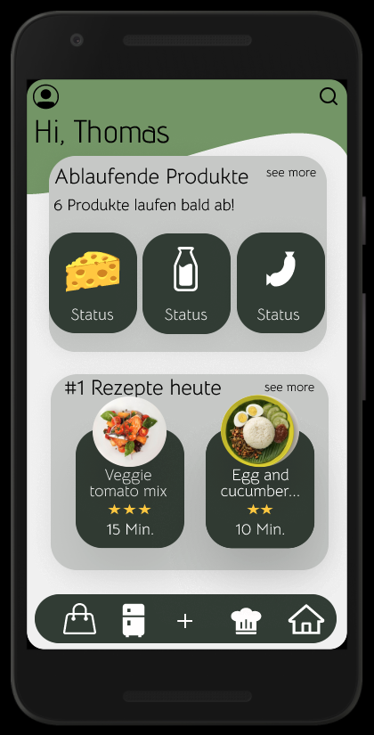
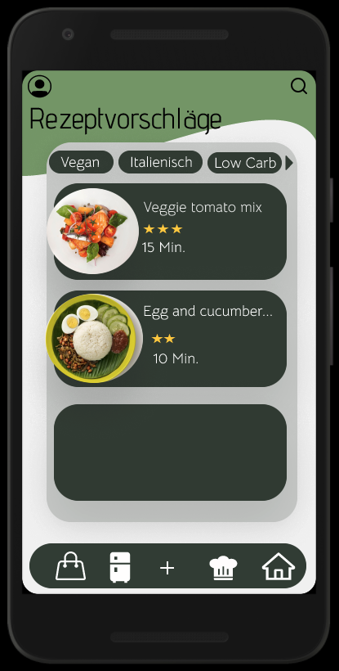
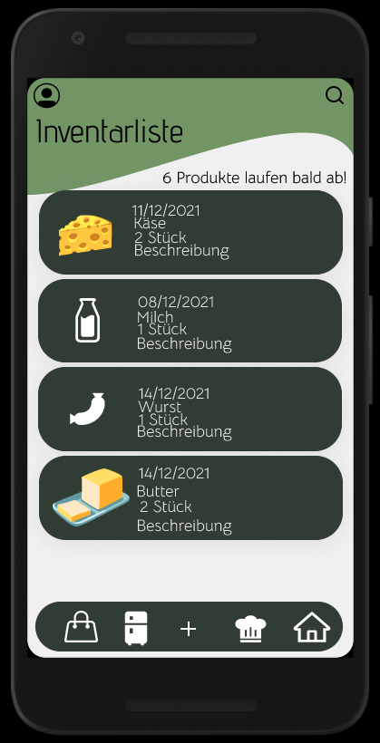


Slide 2





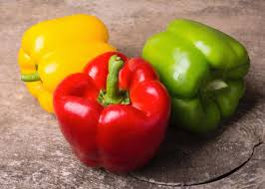
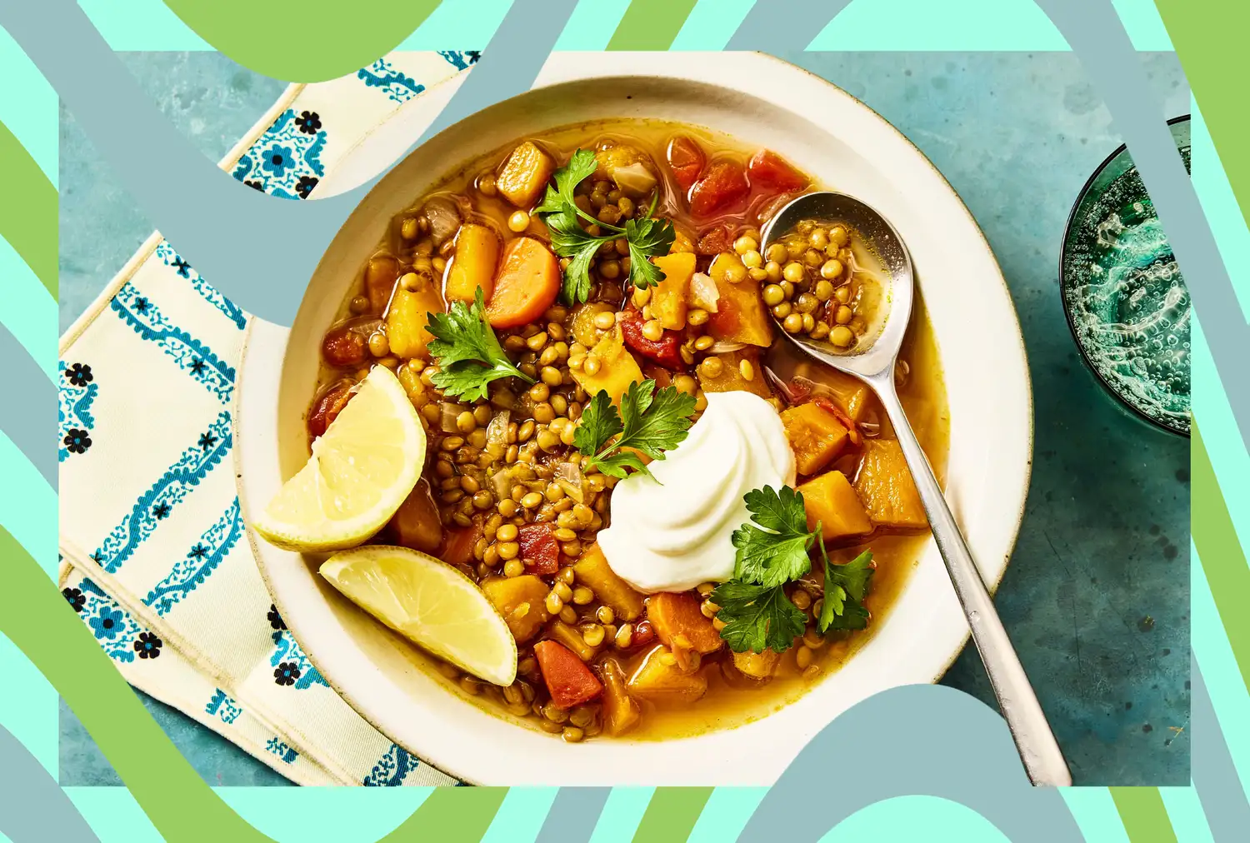
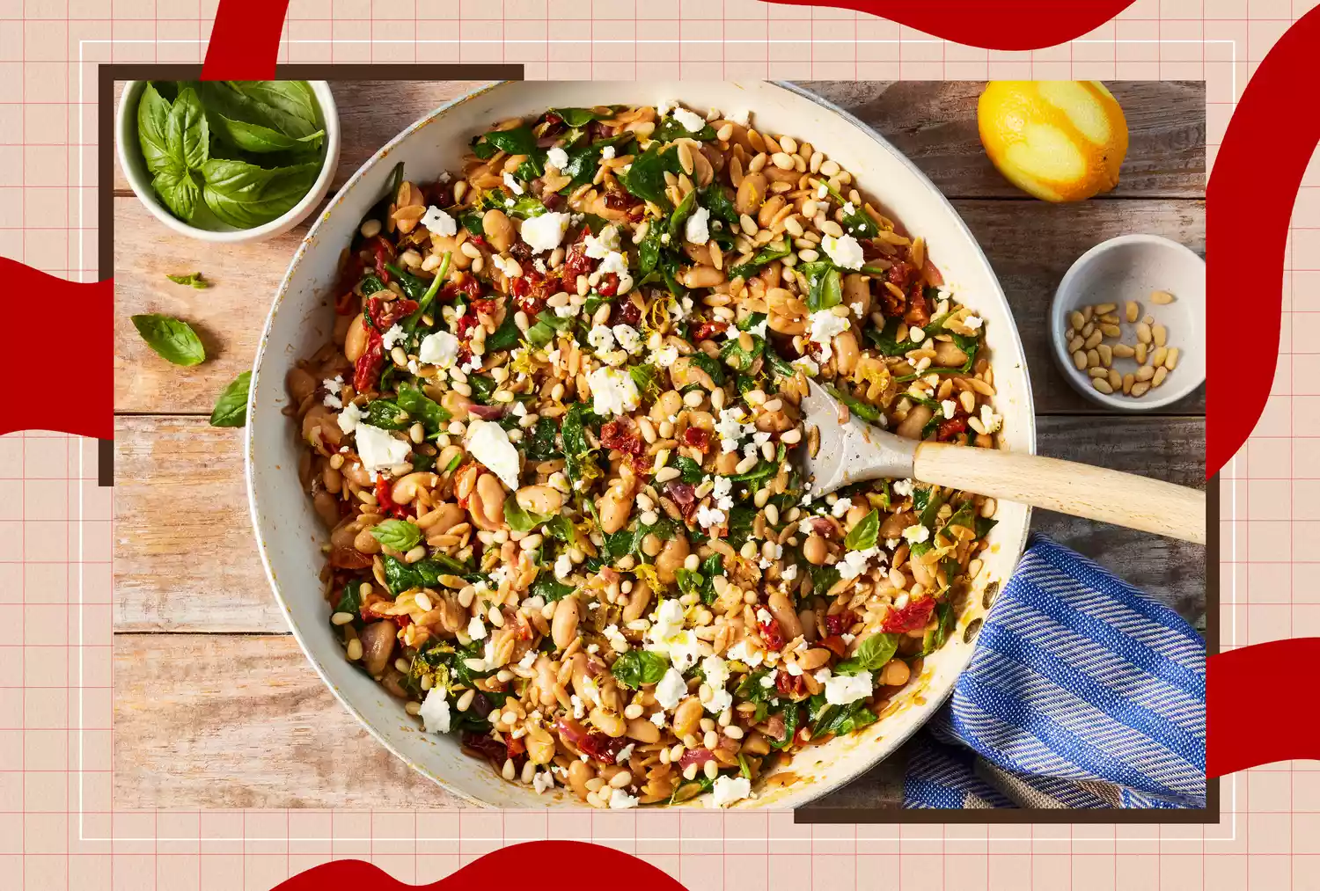



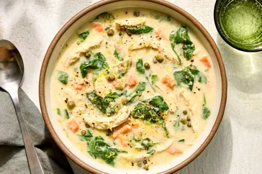
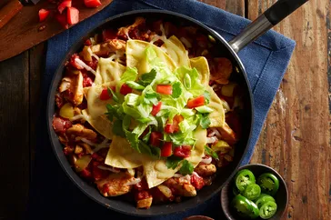
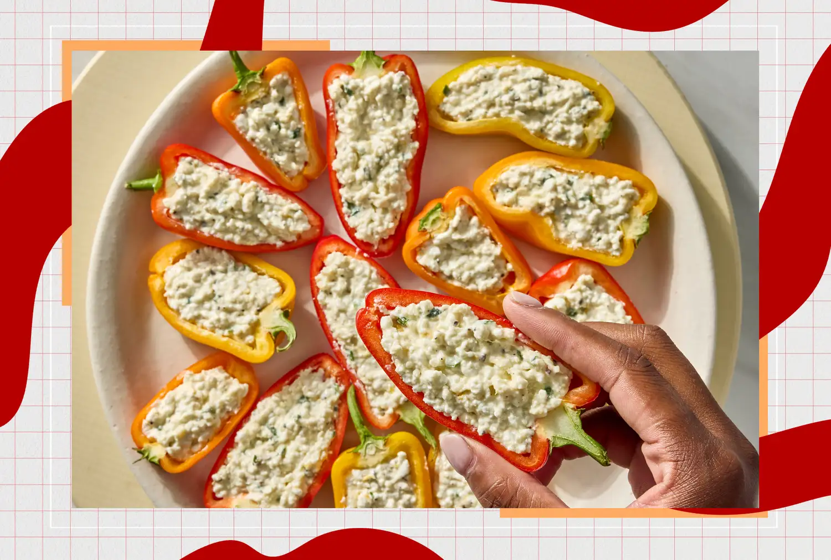
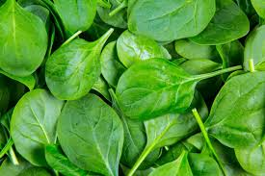


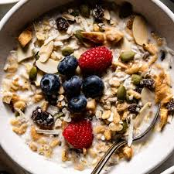

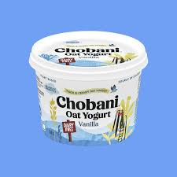
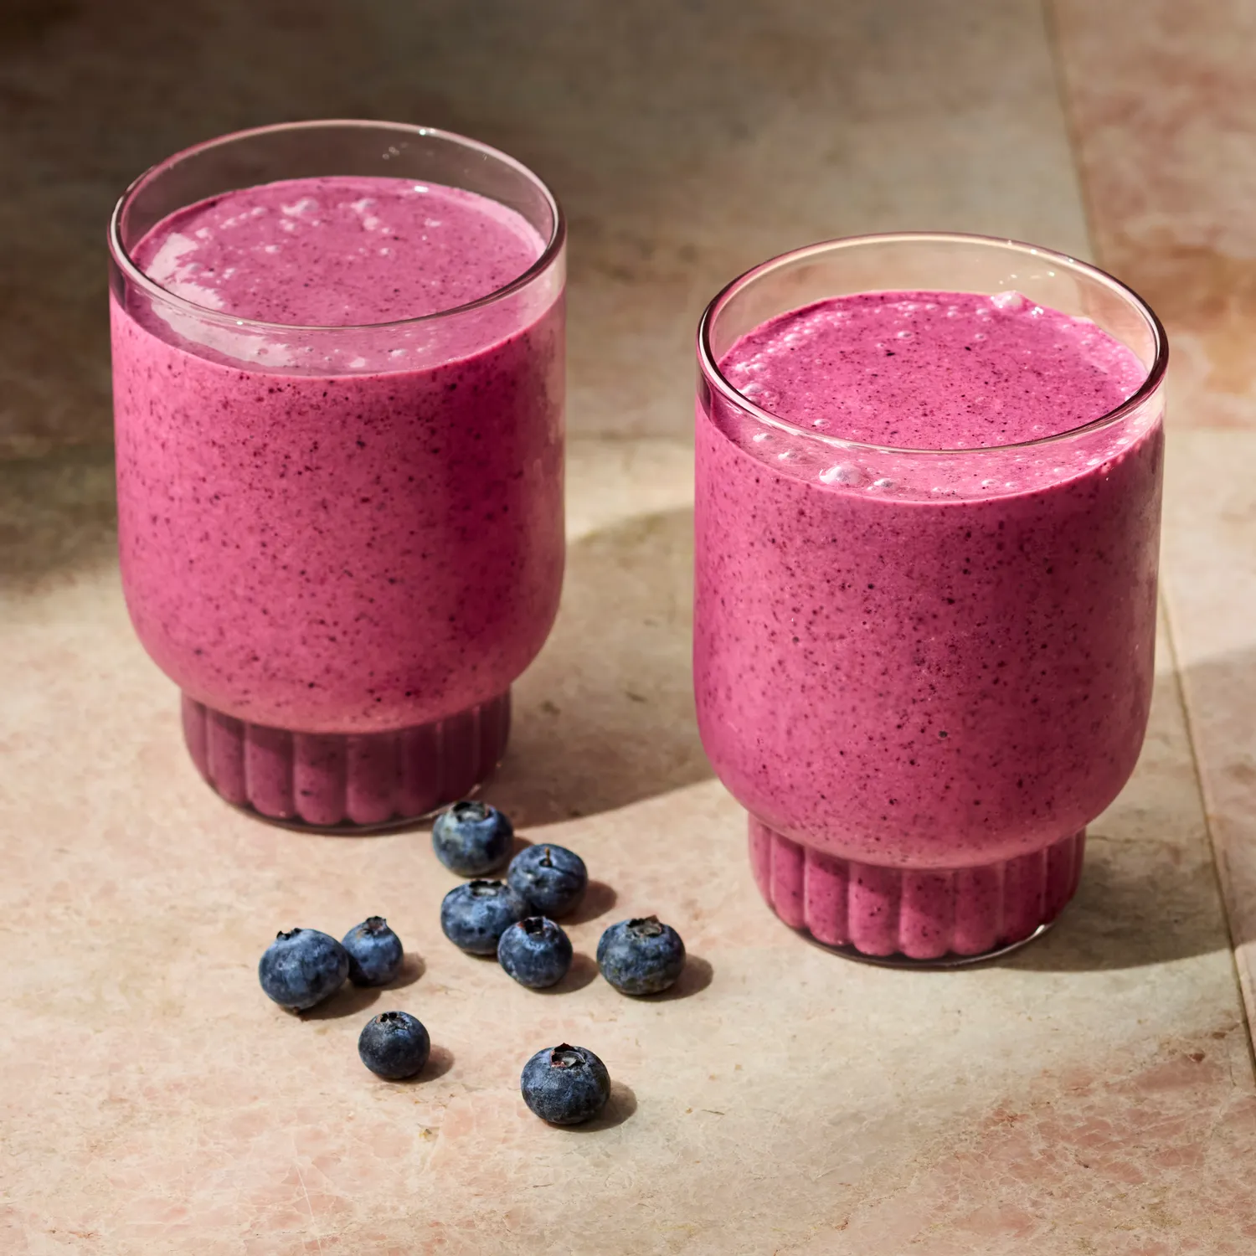
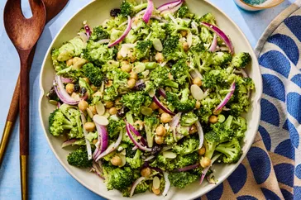

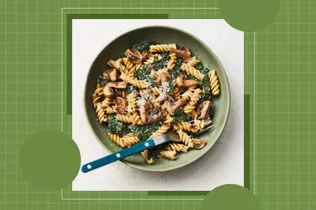
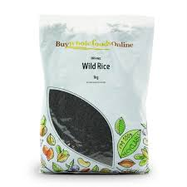
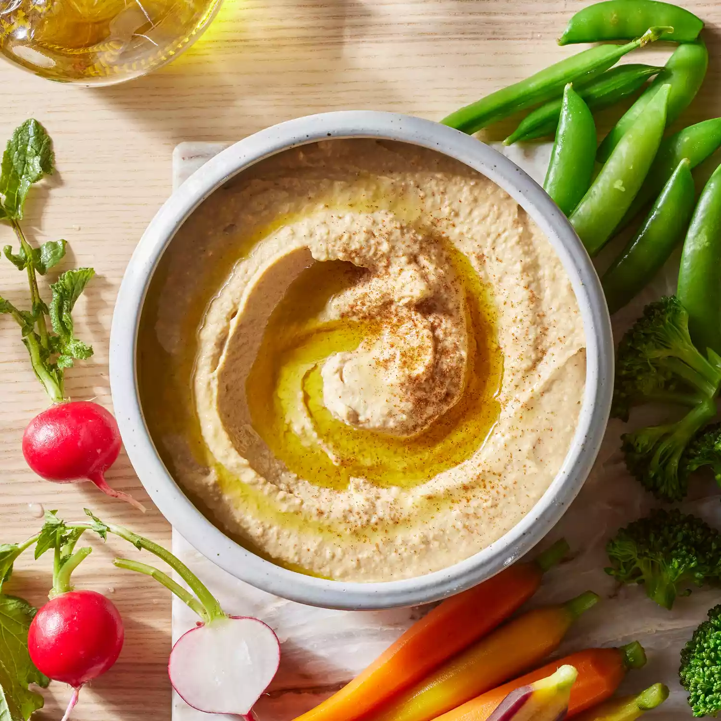


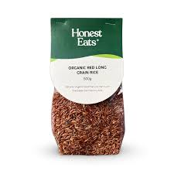
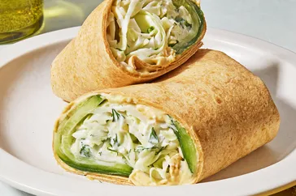
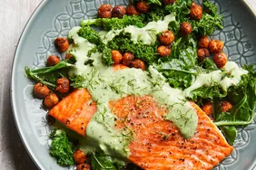


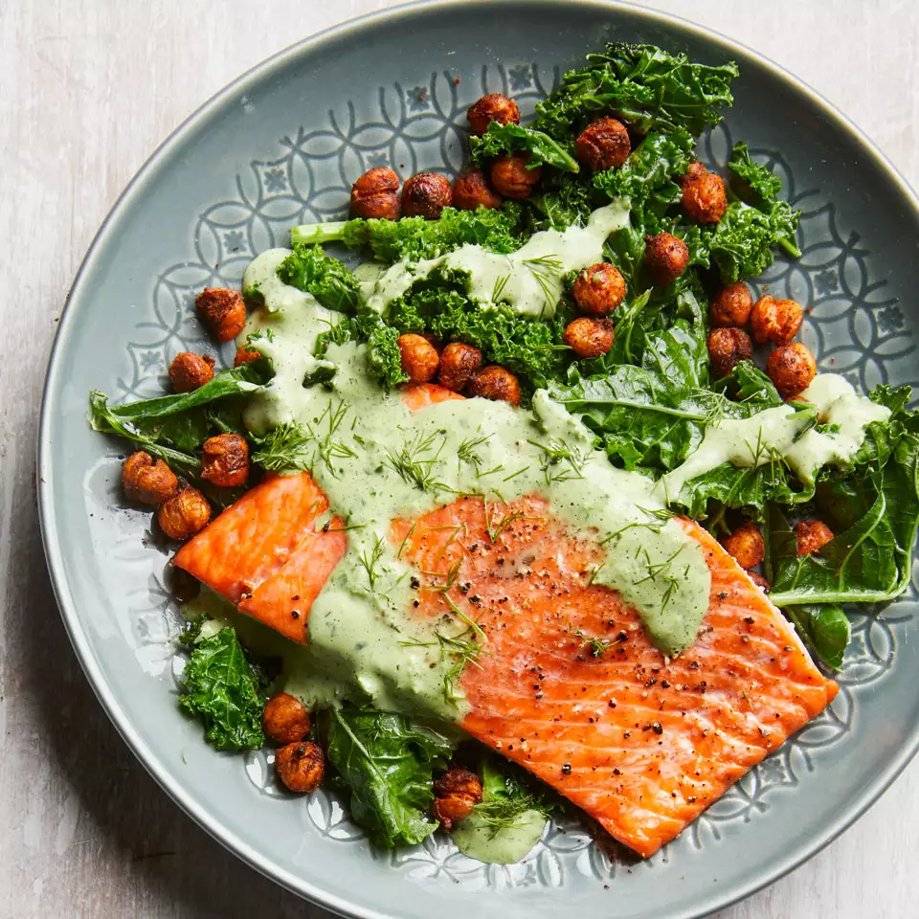

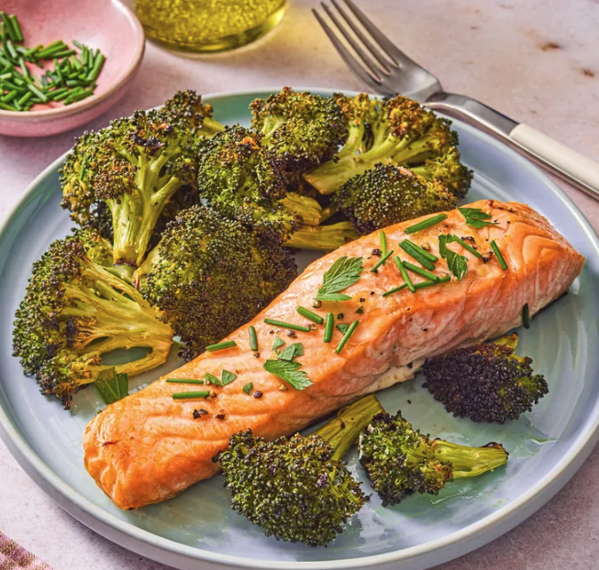
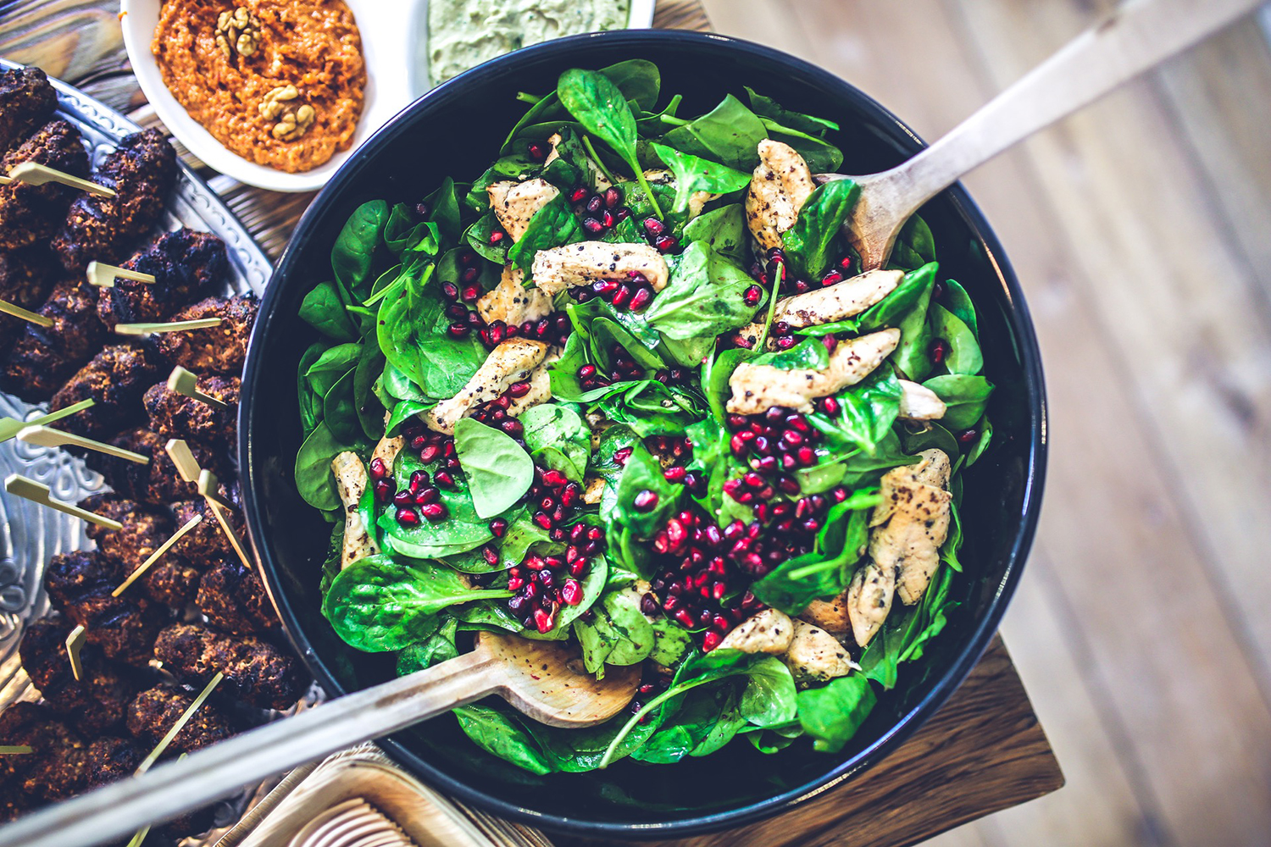
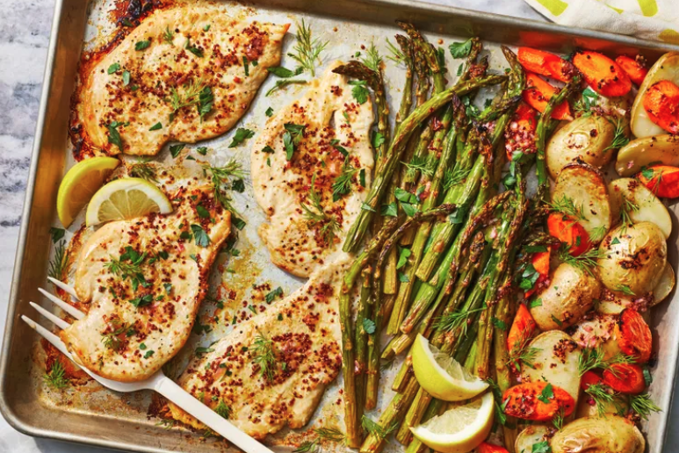


Indicators
Abigail Redcliff
Abigail Redcliff
Abigail Redcliff
Abigail Redcliff
Gluten-free, vegan foodie.
Gluten-free, vegan foodie
Gluten-free, vegan foodie.
Gluten-free, vegan foodie.
What would you like to cook today?
55
Inventory List
33
20
Likes
Shopping List
Following
Followers
Item
Amount
Expiry
Search any recipe
Search saved recipes
3 Gloves
Garlic
100 g
Today
My Recipes
Mushrooms
Categories
See all
500 mg
See all
Almonds
2 pieces
Tomorrow
Fresh Chickpeas
Bell Pepper
Cookly
Dinner
Lunch
Snacks
Dessert
Bre
2 tins
500 g
20/02/2026
2 tins
Bread
Recommendation
Vegan Cream
100 g
23/02/2026
See all
Baby Spinach
Ice Cones
1 pack
100 g
29/02/2026
400 g
Oatly Milk
Raspberries
100 g
05/03/2026
250 g
Muesli
Made It
Mushrooms
See all
500 g
24/03/2026
Creamy Chickensoup
Vegan Spagetthi
Add
Chobani
500 g
24/03/2026
1 hr 30 mins
By Carolyn Casner
45 mins
By Mike De Marco
Red Lentiles
Recently Bought
500 g
25/03/2026
Mealplan For The Week
Noodles
Mannuka Honey
31/05/2026
1 glass
230 g
Wild Rice
Blueberries
Recently Viewed
1 pack
Add
See all
Greek Yoghurt
500 g
Mike De Marco
Abigail Redcliff
Passionate about healthy living.
Gluten-free, vegan foodie.
30k
Follow
12
33
10k
Likes
20
55
Following
Following
Followers
Followers
Likes
Search Mike’s recipes
Consistency Indicators
Recipes
Avg. Score
Creamy Chickensoup
Popular
350
A delicious and hearty meal perfect for slow evenings. Can use alternatives instead of chicken meat, such as chickpeas or vegan soy meat alternatives.
Rank
1 hr 30 mins
Medium
223 Cal
337 - 673
Carolyn Casner
Building Habbits
Passionate chef, biologist by the day.
Crema Salmon
Vegan Spagetthi
30 SEPT – 6 OCT
Nutrients
Sugar
Sport Activities
Ingredients
Instructions
25 mins
45 mins
Fat
Portions
350
35 gr
55 gr
25 hrs/ week
Ingredients
Suggested Friends
Granulated garlic
30 mg
Mike De Marco
Grounded almonds
100 mg
Follow
High-Protein Salmon
Fresh Garden Salad
Passionate about healthy living.
Fresh Chickpeas/Vegan Soy
500 g
25 mins
35 mins
Carolyn Casner
Follow
Vegan Soy-based Cream
250 g
Passionate chef, bio by night.
Baby Spinach
1 package
Bohan Zhang
Follow
Exploring culinary.

Slide 3








Recipe
Service
Redis Cache
http://localhost:6379
User
Service
http://localhost:8083
HTTP Request
Inventory Service
Cookly
HTTP Response
API Gateway
http://localhost:8084
Client
APIs are used by a Kotlin + Android based Mobile App
http://localhost:8000
Grocery Service
http://localhost:8085
Spring Boot
Microservices
PostgreSQL
http://localhost:27017
Server – Private Network

